Slide 1

Team:
P. Prem Sai
P. Lalith
M. Akash
B. Ananth Kumar
Md Shams Tabrez
Under The Guidance of
Mrs.k.SaiLatha
JUST BORN

Slide 2
INDEX
Abstract
What is Just Born
Tool we used
How it works
ER Diagram
Flow Chat
Advantages and Disadvantages
Challenges
Graphical user Interface

Slide 3
Abstract
In this artificial and busy life everyone wants to take care of their newly born babies with genuine products but, they don't find!, these are the questions comes into their mind when they actually search for them
why?
where?
how?
Where here is a solution for a lot of these questions, launching our new website. just born will clear all your doubts and helps you to find all your baby products at one place. Hence, you can call this one stop destination for all your baby needs Starting from (0-3months) category to (10 years) age children's .you can find Clothing, toys and many more.

Slide 4
What is Just Born??
Just Born is Web Based Application.
Our application provides products for infants/kids
Here customers can choose whatever they want from mentioned categories.
We try to provide premium quality products for your loved ones.
This is a user-friendly interface where customers can locate their required products easily.

Slide 5
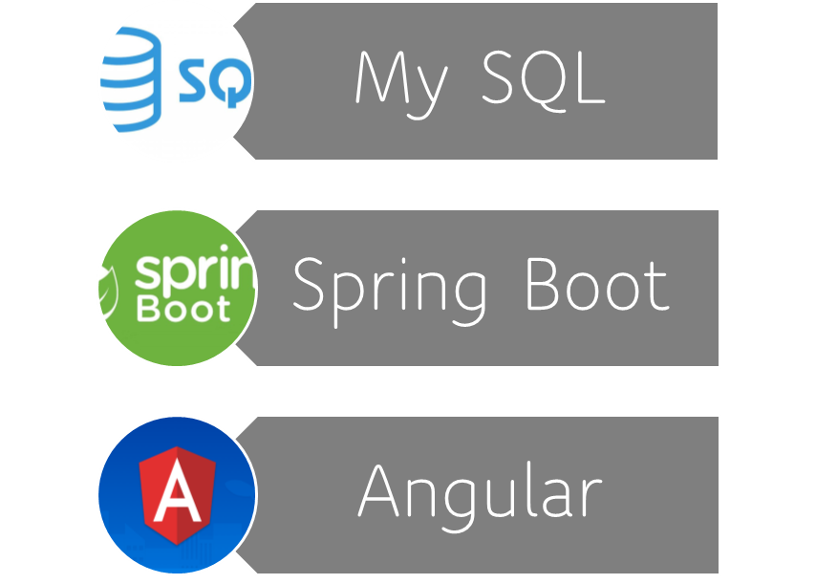
Tools we used
Tools we used
Html
CSS

Slide 6
Flow Chart
Home Page
Register
Login
Admin
Users
Crud Operations
View Products
Categories , product , user data
Add To Cart
Logout
Payment
Logout

Slide 7
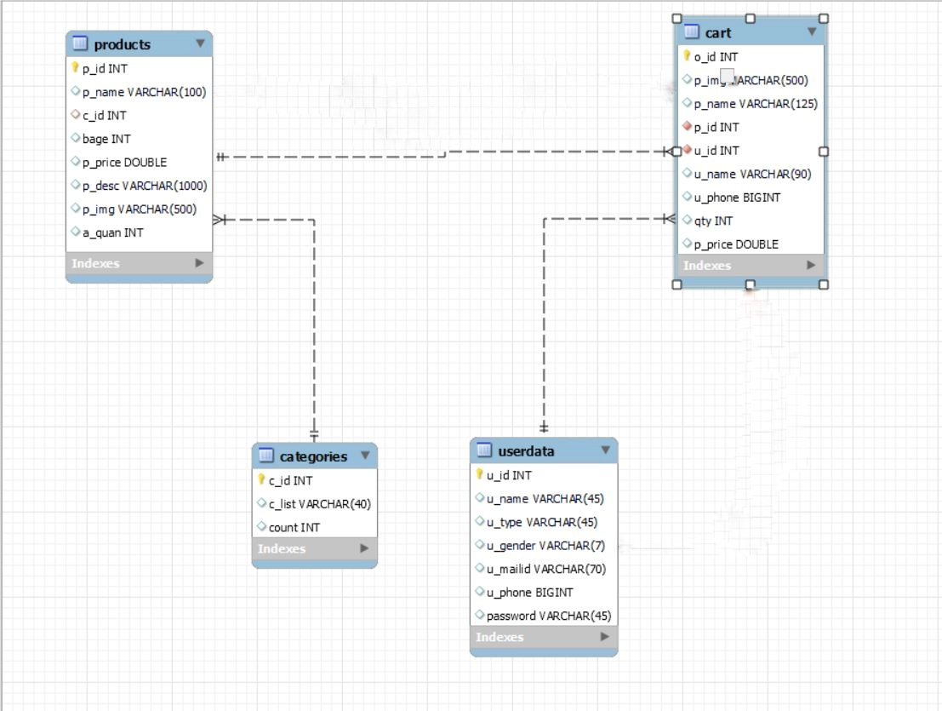
Entity-Relation Diagram:

Slide 8


How it works ?
User
User
Admin
User
Admin
Admin
Admin
SignIn
SignIn
SignIn/SignUp
SignIn
SignIn/SignUp
SignIn
SignIn/SignUp
Product
Product
Insert
Insert
Insert
Categories
Insert
Delete
Categories
Delete
Update
Delete
Delete
Update
User Data
Products
User Data
Products
Products
User Data
Products
User Data
Cart
Products
Products
Cart
Payment
Payment

Slide 9
Advantages of Just Born:-
Faster buying/selling procedure, as well as easy to find products.
Buying/selling 24/7.
More reach to customer, there is no theoretical geographic limitations.
Low operational costs and better quality of services.
No need for physical company set-ups.
Easy to start and message a business.

Slide 10
Disadvantages:
Unable to examine products personally.
Not everyone is connected to the internet.
There is the possibility of credit card number theft.
Mechanical failures can cause unpredictable effects on the total process.

Slide 11
Challenges
Validation
Data Encryption
Search Operation
AddToCart
Payment API

Slide 12
GUI(Graphical User Interface)

Slide 13
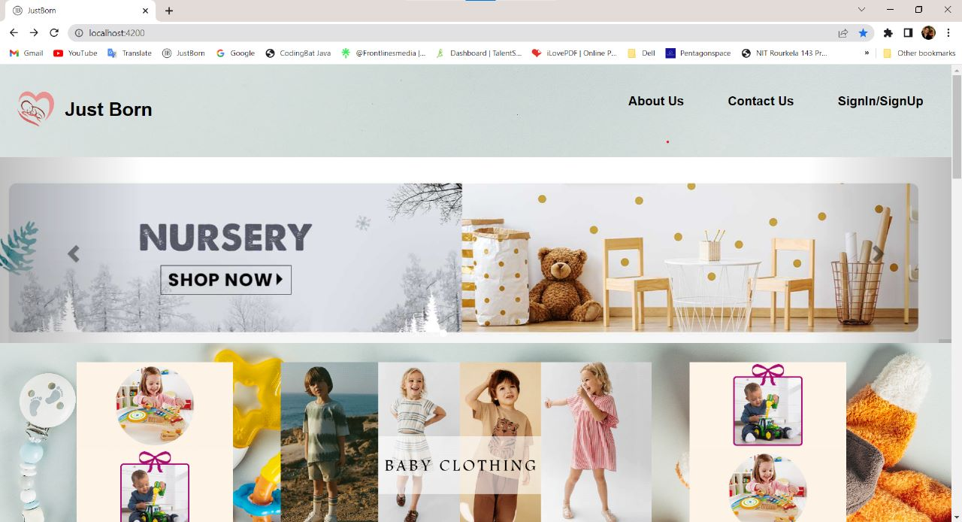
HOME PAGE

Slide 14
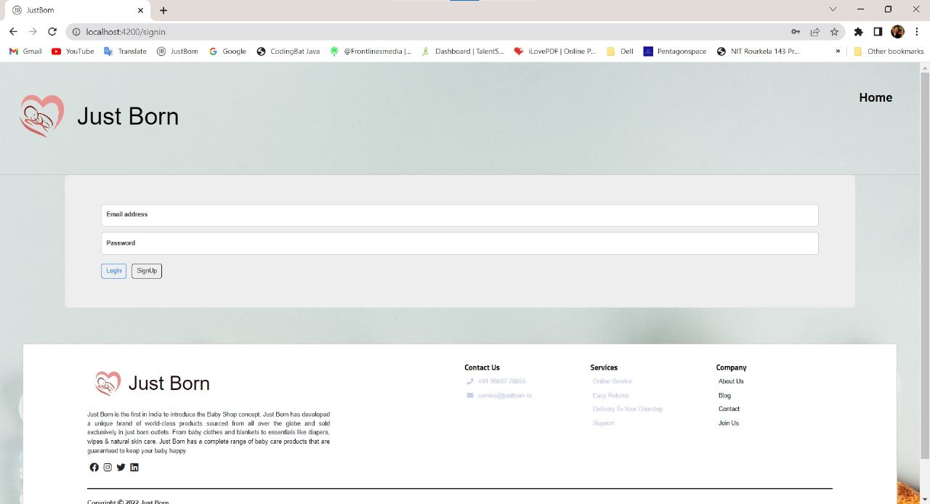
LOGIN PAGE

Slide 15
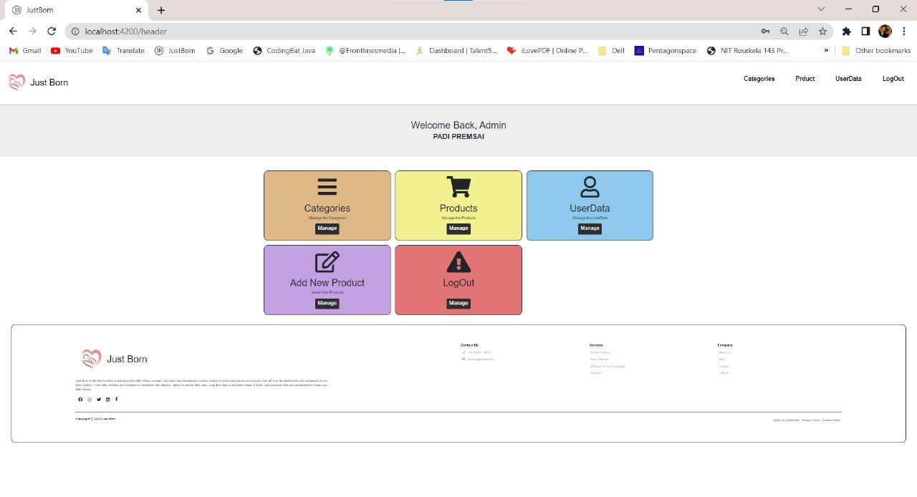
ADMIN PAGE

Slide 16
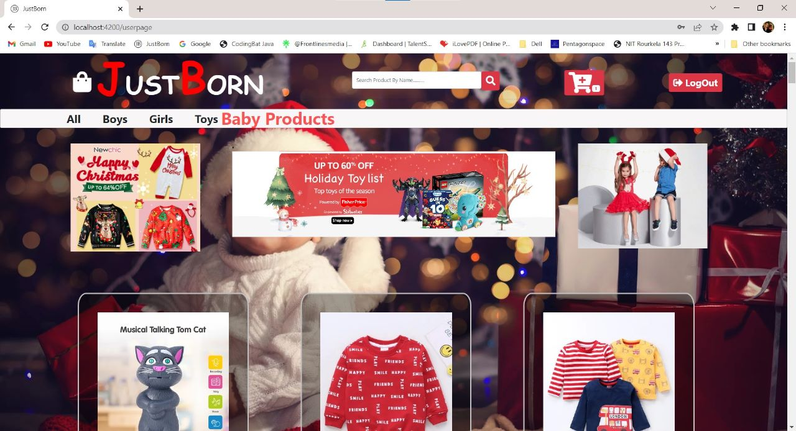
USER PAGE

Slide 17
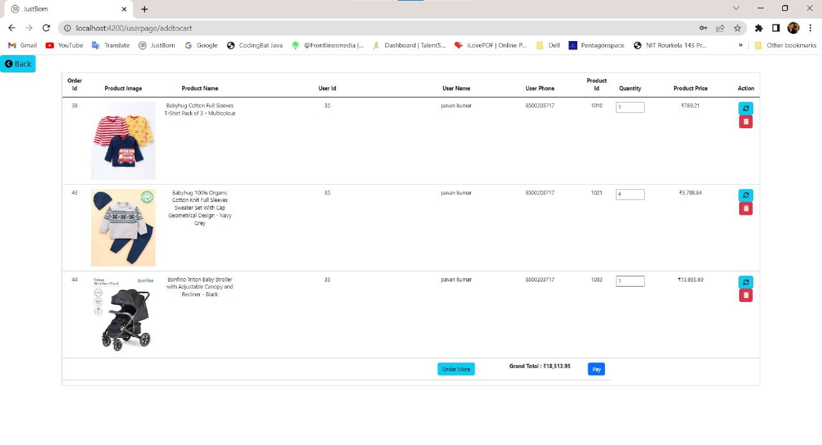
CART PAGE

Slide 18
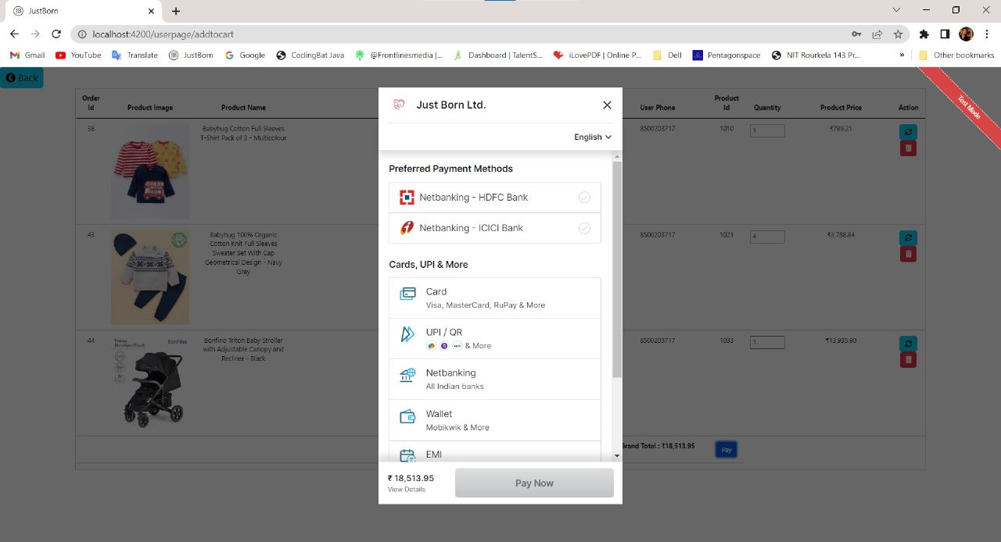
PAYMENT PAGE

Slide 19
Future Scope
We are thinking of some modifications and adding some advanced new features in our system. Some of them are-
# GUI modification(more user friendly)
# Users can signup/login using their social media accounts such as Facebook, google+, etc.
# Auto Bill Generation
# (ADMIN PAGE) Graphical Flow Chart according to the no. of products in each categorie.

Slide 20


